Slide 1




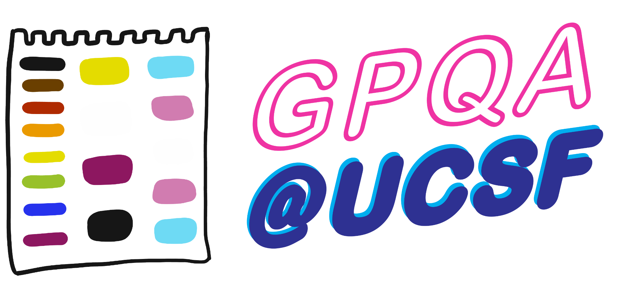


Mastering the Art
of Uncomfortability:
Networking Edition
Naledi Saul
Jaysón Davidson
Notes:
JD: THANK OUR COLLABORATORS - SAY WHAT MOTIVATED YOU TO BRING US TOGETHER TODAY

Slide 2
Agenda: What We’ll Work On Together
A. Strategies to connect
B. The etiquette:
Start the conversation
Maintain the conversation
Exit the conversation, gracefully
Notes:
…just the conversations/relationships you have with people…..while you are pursing your goals.
This is important because people think networking IS the goal - and they think the purpose is to meet as many people as possible. And it isn’t. Your goals, are your professional goals (to learn how to write a grant, to pursue some area of research, to learn a technique, to understand how to apply to graduate school, new PI setting up lab). Networking is just the people you meet purposefully or serendipitously, on the way to your goal. (Refer back to the fact that people raised their hands around goals like : how to approach a senior colleague, or “how to get into a lab/approach possible PhD advisor before applying to program/seeking a collaborator, etc.)
Which is why every researcher knows they should go to a conference to ‘network’, but you need to be clear about what your goals are, or else you cannot engage people professionally in a meaningful way.
The current problems or challenges you face and your efforts to solve them that generates the conversation and begins and maintains the professional relationship, in this case, with the person sitting next to at a conference session, or at your uni., etc. .
So, if you need to need to be clear on your academic/professional goals to be able to network well, how do you identify your academic/professional goals?

Slide 3
Agenda: What We’ll Work On Together
A. Strategies to connect
B. The etiquette:
Start the conversation
Maintain the conversation
Exit the conversation, gracefully
Notes:
…just the conversations/relationships you have with people…..while you are pursing your goals.
This is important because people think networking IS the goal - and they think the purpose is to meet as many people as possible. And it isn’t. Your goals, are your professional goals (to learn how to write a grant, to pursue some area of research, to learn a technique, to understand how to apply to graduate school, new PI setting up lab). Networking is just the people you meet purposefully or serendipitously, on the way to your goal. (Refer back to the fact that people raised their hands around goals like : how to approach a senior colleague, or “how to get into a lab/approach possible PhD advisor before applying to program/seeking a collaborator, etc.)
Which is why every researcher knows they should go to a conference to ‘network’, but you need to be clear about what your goals are, or else you cannot engage people professionally in a meaningful way.
The current problems or challenges you face and your efforts to solve them that generates the conversation and begins and maintains the professional relationship, in this case, with the person sitting next to at a conference session, or at your uni., etc. .
So, if you need to need to be clear on your academic/professional goals to be able to network well, how do you identify your academic/professional goals?

Slide 4
7 Ways to Show Up: What Two Will You Use?
Your Turn! Turn to the person next to you and share which 2 approaches feel most comfortable for you/are your go-to approaches? Take 8 minutes!
1. Show up with.
Intentionality
Thinking about how you want to show up: how you want to engage from your values.
(Value: Transparency) “Hi. My name is Naledi and I came to this workshop b/c I find networking really awkward. What did you hope to get out of today’s session?
2. Meet and Mimic
Meet people where they are at/on a common point. Mimic their energy, approach, topics and language
“Hi yourself! I agree - this is an interesting presentation/ are good muffins, etc.! (If they say hi, you say hi. If they nod, you nod …and then say hi!)
3. Engage with a Spirit
of Curiosity
There are 8 billion people on the planet. How did this person end up here?
“How does the speaker’s work relate to your own?”
Find a connection! Something you have in common or can both relate to!
“I like your hat!” “Where are you from?” “Why did you choose UCSF?” “Are you from California?” “Wild weather we’re having, aren’t we?”
4. Find Your
Common Humanity
Create a research project: what knowledge do you want to crowd source?
“One of my goals over the past two months has been to ask everyone for one piece of advice about choosing a postdoc. What would you tell someone/have you heard?”
5. Have a Goal
6. Take a Wing-Person
Everything is better with a friend. Are you a better opener or conversation-continuer? Bring your hype person along!
“Hello, my name is X and this is my esteemed colleague Y. We are both from Z. Where are you from?”
7. Use Humor
Lighten the mood with a common laugh! Try affiliative (include everyone in the joke) or self enhancing (joke about yourself) humor!
(You see the person is also drinking coffee) “This coffee is giving me isn’t just giving me energy; it’s giving me life!”
Notes:
JD: 2,4, 7
https://www.atlassian.com/blog/teamwork/humor-at-work

Slide 5
Agenda: What We’ll Work On Together
A. Strategies to connect
B. The etiquette:
Start the conversation
Maintain the conversation
Exit the conversation, gracefully
Notes:
…just the conversations/relationships you have with people…..while you are pursing your goals.
This is important because people think networking IS the goal - and they think the purpose is to meet as many people as possible. And it isn’t. Your goals, are your professional goals (to learn how to write a grant, to pursue some area of research, to learn a technique, to understand how to apply to graduate school, new PI setting up lab). Networking is just the people you meet purposefully or serendipitously, on the way to your goal. (Refer back to the fact that people raised their hands around goals like : how to approach a senior colleague, or “how to get into a lab/approach possible PhD advisor before applying to program/seeking a collaborator, etc.)
Which is why every researcher knows they should go to a conference to ‘network’, but you need to be clear about what your goals are, or else you cannot engage people professionally in a meaningful way.
The current problems or challenges you face and your efforts to solve them that generates the conversation and begins and maintains the professional relationship, in this case, with the person sitting next to at a conference session, or at your uni., etc. .
So, if you need to need to be clear on your academic/professional goals to be able to network well, how do you identify your academic/professional goals?

Slide 6
Agenda: What We’ll Work On Together
A. Strategies to connect
B. The etiquette:
Start the conversation
Maintain the conversation
Exit the conversation, gracefully
Notes:
…just the conversations/relationships you have with people…..while you are pursing your goals.
This is important because people think networking IS the goal - and they think the purpose is to meet as many people as possible. And it isn’t. Your goals, are your professional goals (to learn how to write a grant, to pursue some area of research, to learn a technique, to understand how to apply to graduate school, new PI setting up lab). Networking is just the people you meet purposefully or serendipitously, on the way to your goal. (Refer back to the fact that people raised their hands around goals like : how to approach a senior colleague, or “how to get into a lab/approach possible PhD advisor before applying to program/seeking a collaborator, etc.)
Which is why every researcher knows they should go to a conference to ‘network’, but you need to be clear about what your goals are, or else you cannot engage people professionally in a meaningful way.
The current problems or challenges you face and your efforts to solve them that generates the conversation and begins and maintains the professional relationship, in this case, with the person sitting next to at a conference session, or at your uni., etc. .
So, if you need to need to be clear on your academic/professional goals to be able to network well, how do you identify your academic/professional goals?

Slide 7

Feeling Comfortable: Your 2 goals when engaging? uncover your connection!
There are 8 million people on the planet Earth.
You can talk to any of them.
But how you approach them
How much time you spend with them, and
How you speak with them
differs based on your relationship.

Slide 8

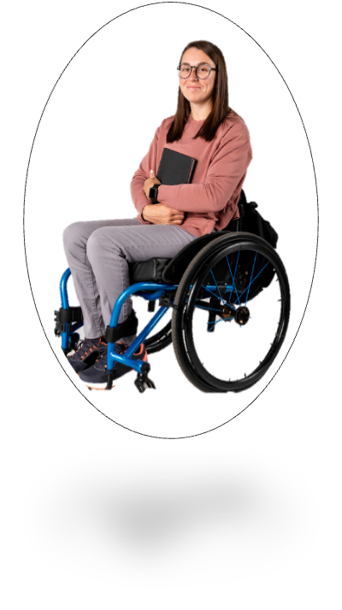

Feeling Comfortable: Your 2 goals when engaging?
Get your data; uncover the relationship.
The farther people are from you, the more clear and concise you need to be
People you know
People who are the same stage in their career
People who know your friends or colleagues
People 1-2 stages ahead in their careers
People you don’t know at all
People who are senior in their field

Slide 9

N.O.W: Name, Organization, What do you want to talk about?
Your opening bid: You are concise, informational and end with an invitation (to engage).
Your Turn! Take 5 minutes to start a conversation
Name
Organization
(affiliation)
What do you want to talk about?
I’m in TETRAD
What do you think about this session so far?/
Have you ever heard Naledi and Jaysón present before?
Hello, I’m Kamala Khan
  Have you attended professional development workshops on campus before? What did you find most useful?
Pause
  Have you attended this conference/event before? What do you appreciate most about it?
  How does the speaker’s work relate to you your own?
  What information has interested you the most? Why?
Amazing weather we’re having! Have you ever seen it like this in San Francisco?
Notes:
JD: will be doing the ‘what do you want to talk about section.

Slide 10
Agenda: What We’ll Work On Together
A. Strategies to connect
B. The etiquette:
Start the conversation
Maintain the conversation
Exit the conversation, gracefully
Notes:
…just the conversations/relationships you have with people…..while you are pursing your goals.
This is important because people think networking IS the goal - and they think the purpose is to meet as many people as possible. And it isn’t. Your goals, are your professional goals (to learn how to write a grant, to pursue some area of research, to learn a technique, to understand how to apply to graduate school, new PI setting up lab). Networking is just the people you meet purposefully or serendipitously, on the way to your goal. (Refer back to the fact that people raised their hands around goals like : how to approach a senior colleague, or “how to get into a lab/approach possible PhD advisor before applying to program/seeking a collaborator, etc.)
Which is why every researcher knows they should go to a conference to ‘network’, but you need to be clear about what your goals are, or else you cannot engage people professionally in a meaningful way.
The current problems or challenges you face and your efforts to solve them that generates the conversation and begins and maintains the professional relationship, in this case, with the person sitting next to at a conference session, or at your uni., etc. .
So, if you need to need to be clear on your academic/professional goals to be able to network well, how do you identify your academic/professional goals?

Slide 11
Agenda: What We’ll Work On Together
A. Strategies to connect
B. The etiquette:
Start the conversation
Maintain the conversation
Exit the conversation, gracefully
Notes:
…just the conversations/relationships you have with people…..while you are pursing your goals.
This is important because people think networking IS the goal - and they think the purpose is to meet as many people as possible. And it isn’t. Your goals, are your professional goals (to learn how to write a grant, to pursue some area of research, to learn a technique, to understand how to apply to graduate school, new PI setting up lab). Networking is just the people you meet purposefully or serendipitously, on the way to your goal. (Refer back to the fact that people raised their hands around goals like : how to approach a senior colleague, or “how to get into a lab/approach possible PhD advisor before applying to program/seeking a collaborator, etc.)
Which is why every researcher knows they should go to a conference to ‘network’, but you need to be clear about what your goals are, or else you cannot engage people professionally in a meaningful way.
The current problems or challenges you face and your efforts to solve them that generates the conversation and begins and maintains the professional relationship, in this case, with the person sitting next to at a conference session, or at your uni., etc. .
So, if you need to need to be clear on your academic/professional goals to be able to network well, how do you identify your academic/professional goals?

Slide 12

WARM RELATIONSHIP: Add one point and one question.
Your goals? You are concise, informational and end with an invitation (to engage).
What do you think of the session program so far?
Oh. It’s great. I already met two people in biotech, which was my goal for this networking session. What about you?
Oh, I just appreciated the panel - I don’t think I’m ready to meet anyone yet. What are you inspired to do after attending this session?
I’m not sure. I’m thinking of signing up for job alerts from job boards and specific company websites, so I can get potential opportunities pushed out to me. What will you be doing next?

Slide 13

COOLER RELATIONSHIP: One point and one question goes one way.
Your goals: You are concise, informational and end with an invitation (to engage).
Do you think that scientists need additional training to pursue a career in science policy?
No. I think for the science part, you need the degree. For the policy, you need experience.
While finishing my Ph.D., as I was writing my dissertation, I worked on refining my policy-career objectives. I boned up on the areas of policy of interest, like pubic health and biosecurity issues, and honed in on a few key questions of contemporary relevance.
That’s helpful to know. I’d like to work on policy issues that are an extension of my research area – like yours, it’s immunology - what experience helped you?
Oh- that’s useful to hear - thanks so much for sharing. What motivated you to speak to us on the panel tonight?
Look for the common connection!
Notes:
JD> WILL MAKE POINT ABOUT COMMONALITY

Slide 14

Don’t Be a Conversational Vampire!
The top 2 reasons people stop wanting to talk to you
You slide: you slip from a ‘conversation’ to a ‘career counseling appointment’
Notes:
…just the conversations/relationships you have with people…..while you are pursing your goals.
This is important because people think networking IS the goal - and they think the purpose is to meet as many people as possible. And it isn’t. Your goals, are your professional goals (to learn how to write a grant, to pursue some area of research, to learn a technique, to understand how to apply to graduate school, new PI setting up lab). Networking is just the people you meet purposefully or serendipitously, on the way to your goal. (Refer back to the fact that people raised their hands around goals like : how to approach a senior colleague, or “how to get into a lab/approach possible PhD advisor before applying to program/seeking a collaborator, etc.)
Which is why every researcher knows they should go to a conference to ‘network’, but you need to be clear about what your goals are, or else you cannot engage people professionally in a meaningful way.
The current problems or challenges you face and your efforts to solve them that generates the conversation and begins and maintains the professional relationship, in this case, with the person sitting next to at a conference session, or at your uni., etc. .
So, if you need to need to be clear on your academic/professional goals to be able to network well, how do you identify your academic/professional goals?

Slide 15
Think “conversation, not counseling appointment”
A Conversation (Your goals/their story)
What is a typical week like as a AAAS Science Communication Fellow?
What skills and experiences prepared you for your current role? How were you able to make it clear that you had the skills needed to pursue an industry career?
What type of professional opportunities interest you 5-10 years down the road?
How did you enter industry from an academic postdoc? Is that a common path?
In your experience, how have people found opportunities in your field?
What is the average salary range for Medical Science Liaison positions?
A Counseling Appointment (Your goals/your story)
How do you suggest I find contacts in your organization?
How can I best make it clear that I have the skills and interest to pursue a career in industry?
I know a career path that is financially stable is important to me. What other jobs would be a good fit for me?
What’s a compelling way for me to talk about why I’m leaving academe?
How do you suggest I find contacts in your organization?
How much should I ask for in salary
It’s your goal, but their story. Your goals+your story= too much you.
Notes:
It’s not a counseling appointment, it’s a conversation.
to network well, how do you identify your academic/professional goals?
In both examples, you will see that Diana shares something about her own professional goals, and then inquires about the other person.
Dissertation committee problem: What’s one thing you did that helpe you manage your disseration committee. How did you manage the differences in what qualified as schoarship?
Or interview question: can you talk about how the inerview process is strcutred ?...down down til you get to, well do you think I should include my metholody in my presentation?
Just like your PhD advisor will take yon more of you than a faculty person, the sme here.
You can’t affect a mentorship relationship immediately. Don’t dive into it. Premature mentorship. Doesn’t work – sound like a burden.

Slide 16
Don’t Be a Conversational Vampire!
The top 2 reasons people stop wanting to talk to you
You slide: you slip from a ‘conversation’ to a ‘career counseling appointment’
You overwhelm: you try to get all your questions answered at once.
    Your first conversation is like a first date. Chat for 10-15 minutes and end.
    If you don’t suck them dry the first time, you’ll have a reason to contact them later….which is the beginning of building a long term professional relationship.)
Notes:
…just the conversations/relationships you have with people…..while you are pursing your goals.
This is important because people think networking IS the goal - and they think the purpose is to meet as many people as possible. And it isn’t. Your goals, are your professional goals (to learn how to write a grant, to pursue some area of research, to learn a technique, to understand how to apply to graduate school, new PI setting up lab). Networking is just the people you meet purposefully or serendipitously, on the way to your goal. (Refer back to the fact that people raised their hands around goals like : how to approach a senior colleague, or “how to get into a lab/approach possible PhD advisor before applying to program/seeking a collaborator, etc.)
Which is why every researcher knows they should go to a conference to ‘network’, but you need to be clear about what your goals are, or else you cannot engage people professionally in a meaningful way.
The current problems or challenges you face and your efforts to solve them that generates the conversation and begins and maintains the professional relationship, in this case, with the person sitting next to at a conference session, or at your uni., etc. .
So, if you need to need to be clear on your academic/professional goals to be able to network well, how do you identify your academic/professional goals?

Slide 17
WARM RELATIONSHIP: Add one point and one question.
Your goals? You are concise, informational and end with an invitation (to engage).
What do you think of the session program so far?
Oh. It’s great. I already met two people in biotech, which was my goal for this networking session. What about you?
Oh, I just appreciated the panel - I don’t think I’m ready to meet anyone yet. What are you inspired to do after attending this session?
I’m not sure. I’m thinking of signing up for job alerts from job boards and specific company websites, so I can get potential opportunities pushed out to me. What will you be doing next?
Your turn! Start and maintain your conversation

Slide 18
Agenda: What We’ll Work On Together
A. Strategies to connect
B. The etiquette:
Start the conversation
Maintain the conversation
Exit the conversation, gracefully
Notes:
…just the conversations/relationships you have with people…..while you are pursing your goals.
This is important because people think networking IS the goal - and they think the purpose is to meet as many people as possible. And it isn’t. Your goals, are your professional goals (to learn how to write a grant, to pursue some area of research, to learn a technique, to understand how to apply to graduate school, new PI setting up lab). Networking is just the people you meet purposefully or serendipitously, on the way to your goal. (Refer back to the fact that people raised their hands around goals like : how to approach a senior colleague, or “how to get into a lab/approach possible PhD advisor before applying to program/seeking a collaborator, etc.)
Which is why every researcher knows they should go to a conference to ‘network’, but you need to be clear about what your goals are, or else you cannot engage people professionally in a meaningful way.
The current problems or challenges you face and your efforts to solve them that generates the conversation and begins and maintains the professional relationship, in this case, with the person sitting next to at a conference session, or at your uni., etc. .
So, if you need to need to be clear on your academic/professional goals to be able to network well, how do you identify your academic/professional goals?

Slide 19
Agenda: What We’ll Work On Together
A. Strategies to connect
B. The etiquette:
Start the conversation
Maintain the conversation
Exit the conversation, gracefully
Notes:
…just the conversations/relationships you have with people…..while you are pursing your goals.
This is important because people think networking IS the goal - and they think the purpose is to meet as many people as possible. And it isn’t. Your goals, are your professional goals (to learn how to write a grant, to pursue some area of research, to learn a technique, to understand how to apply to graduate school, new PI setting up lab). Networking is just the people you meet purposefully or serendipitously, on the way to your goal. (Refer back to the fact that people raised their hands around goals like : how to approach a senior colleague, or “how to get into a lab/approach possible PhD advisor before applying to program/seeking a collaborator, etc.)
Which is why every researcher knows they should go to a conference to ‘network’, but you need to be clear about what your goals are, or else you cannot engage people professionally in a meaningful way.
The current problems or challenges you face and your efforts to solve them that generates the conversation and begins and maintains the professional relationship, in this case, with the person sitting next to at a conference session, or at your uni., etc. .
So, if you need to need to be clear on your academic/professional goals to be able to network well, how do you identify your academic/professional goals?

Slide 20

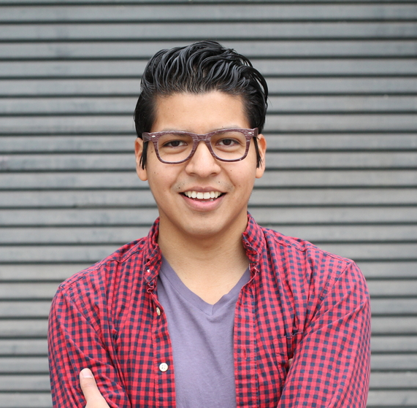
Ending a Conversation, Gracefully:
It’s all about using language that signals you’re ending
When winding down the conversation, Miles Morales waits for a pause and says:
Well, it was nice to meet you. Maybe we’ll see each other around.
Well, it was great speaking with you. I hope the meeting is productive for you.
Signal! Give the other person a moment to register the winding down of the conversation and shift gears.
Notes:
…Remember that the other person may need a moment to register that the conversation is ending. A nonverbal cue, like holding out your hand for a handshake, helps signal the end of a conversation
Whomever ends the conversation is obliged to engage in all of the non verbal cues – such as walking away after shaking the other person’s hand, or returning to reading your conference materials, etc.
.

Slide 21
Your Turn: Here are 6 graceful exits.
Land your plane…and gracefully end your conversation.
….in 5 minutes!
It was a pleasure speaking with you. I hope you have a great night/very productive time at the conference/I hope you find this session useful.
I’m sorry to interrupt (because this is quite interesting), but I wanted connect with Bruce Banner and it looks like he might be leaving. It was great to speak with you. I hope we will run into each other again.
(Express appreciation) Well, it was great to meet you. Thanks so much for your advice. I really appreciate it.
(Be specific) It was good talking with you – it was very helpful hearing what three criteria you used to evaluate postdoc options and what questions you asked during the interview. Thank you.
(Got an informational interview!) Thank you. I look forward to speaking with you tomorrow at 4pm.
(Want to keep in touch) Thanks for the advice/insight. It’s been a valuable conversation. I’d like to let you know how it goes. Could we keep in touch?
A general ending:
Ending if the person offered you advice:
Notes:
JD: WILL DO THIS SLIDE
Discuss the etiquette around ending a conversation.

Slide 22
What We Worked On
A. Strategies to connect
B. The etiquette:
Start the conversation
Maintain the conversation
Exit the conversation, gracefully
You’re
ready
to go!
Notes:
JD GOING TO DO THE CLOSE. - FINAL WORD OF INSPIRATION/MOTIVATION!
This is important because people think networking IS the goal - and they think the purpose is to meet as many people as possible. And it isn’t. Your goals, are your professional goals (to learn how to write a grant, to pursue some area of research, to learn a technique, to understand how to apply to graduate school, new PI setting up lab). Networking is just the people you meet purposefully or serendipitously, on the way to your goal. (Refer back to the fact that people raised their hands around goals like : how to approach a senior colleague, or “how to get into a lab/approach possible PhD advisor before applying to program/seeking a collaborator, etc.)
Which is why every researcher knows they should go to a conference to ‘network’, but you need to be clear about what your goals are, or else you cannot engage people professionally in a meaningful way.
The current problems or challenges you face and your efforts to solve them that generates the conversation and begins and maintains the professional relationship, in this case, with the person sitting next to at a conference session, or at your uni., etc. .
So, if you need to need to be clear on your academic/professional goals to be able to network well, how do you identify your academic/professional goals?

Slide 23
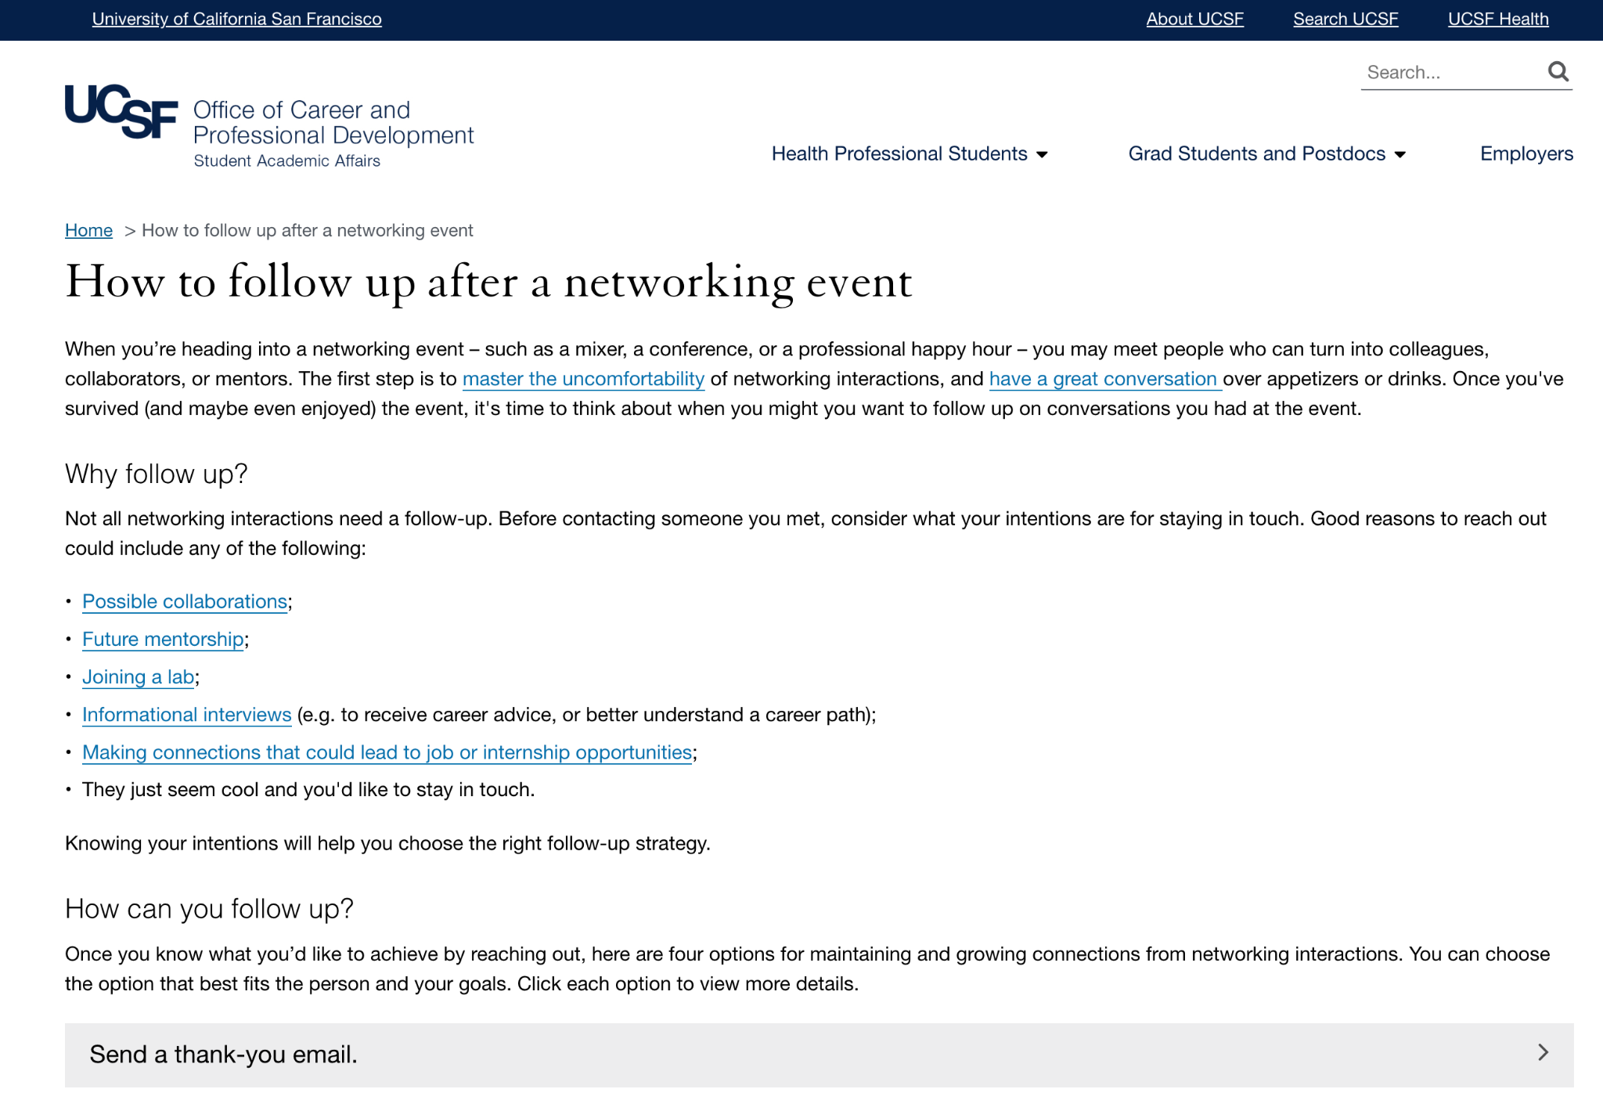
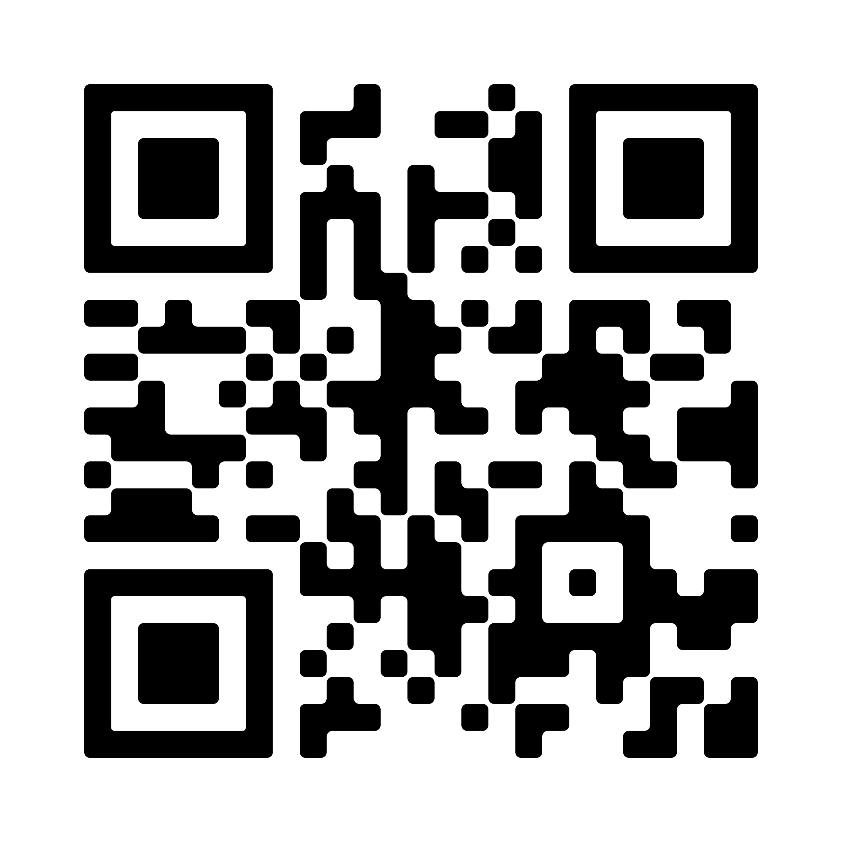
How to Follow up After a Networking Event

Slide 24
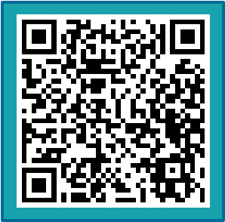
Mastering the Art
of Uncomfortability:
Networking Edition
Naledi Saul
Jaysón Davidson
Notes:
30 minutes: get in, have, end convo
7 minutes: strategies
7 minutes: Which two will you use
AFTERWARDS : give a handout about how to continue the relationship.

